Slide 1
INDUSTRIAL AQUA CULTURE (RAS)
SINOR AS

Slide 2
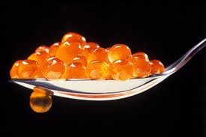
CRUNCHY TROUT EGGS – CAVIAR
Notes:
Salmon eggs – so crunchy that it is hard to explain
Delicious and so big that you could play table tennis
SO WHY DID SALMON BECOME BIG BUSINESS?

Slide 3
SPECIFICATION
To produce Rainbow Trout at a butchering weight of 5 kg+
By use of R.A.S. (Recirculation Aquaculture System)
Yearly production of 2.000 metric tons per year

Slide 4
IMPORTANT RAS ISSUES
No antibiotics used
Environmentally friendly and sustainable
2 % use of water compared to flow-through fish farms
Sludge can be used for biogas production or as fertilizer
Reduced CO₂ emissions
Fully traceable production
Low FCR
Write-off period is 20 years, but reference show operation of more than 30 years+ and continuing with original parts

Slide 5
GENERAL MARKET BACKGROUND
Before 2025, the World Population is expected to exceed 10 billion people
Over this period the total food production will increase by 70%
Notes:
2025 – 10 bill
70% increase in food production

Slide 6
GENERAL MARKET BACKGROUND
The majority of this population will be urbanized
The importance of nutrient, safe, healthy sea food will play an increasingly important role for both the society and the consumer
Sustainability is a global challenge
FAO has emphasised the importance of the aqua culture industry in the future supply of healthy food, encouraging all nations to take advantage of the new opportunities
The EU is investing substantially into new aqua culture technology, DNA and sustainable feed supplies
Notes:
Urbanized
Safe food – sea food - reduced cost for the society (cola & hamburgers, alcohol & cigarettes)
It feels good to speak the word SUSTAINABLE
It gives us all hopes for the future of the planet.

Slide 7
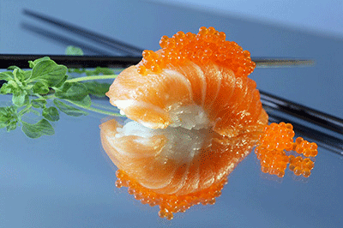
SALMON or TROUT – A FAVORITE SUSHI
Notes:
NORWEGIAN ATLANTIC SALMON & SALMON CAVIAR
SASHIMI – a favourite dish, but for best quality it is tailor produced.
The most popular salmon dish world wide is the sashimi

Slide 8
THE PROSPECT OF THE BLUE ECONOMY
Sea-caught fisheries will be conservation-managed to seek to maintain present levels of production.
While Aquaculture production will continue it’s ongoing trend to provide a larger proportion of total fish production.
Total fish consumption per head will increase for health reasons.
The limitation of sea water locations due to both environmental and legislative reasons, will support and move the sea food farming from the sea to land based locations.
Notes:
Sea caught fish conservation managed
Aqua culture will grow
Limited sea water locations
Clean water reseource will demand R.A.S.

Slide 9
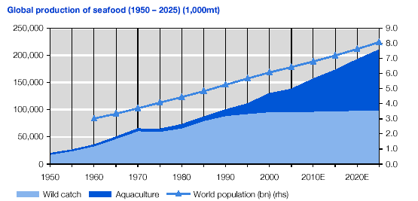

Slide 10
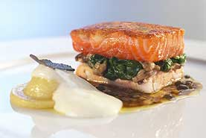
TROUT or SALMON – THE NORWEGIAN WAY
Notes:
TEXTURE of the flesh is very important, the high level of OMEGA 3 maintains the texture
- And slaughtered correctly and kept on ice – salmon has a remarkable shelf life compared to most other spices.

Slide 11
CHARACTERISTICS OF RAS FARMED ATLANTIC SALMON OR TROUT
State of the art technology
World class feed
World class eggs/DNA
World leading management systems
Disease prevention
Waste handling
Processing of the end-product

Slide 12
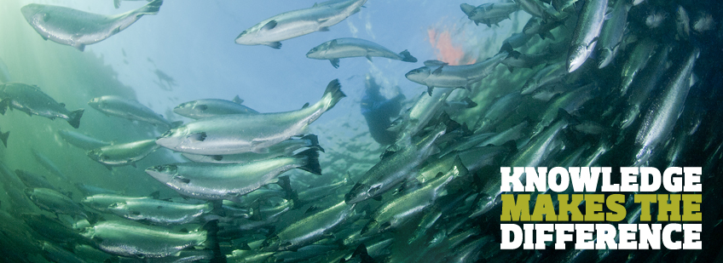
KNOWLEDGE
Notes:
Who said Salmon farming is easy…..?
And what does it really take to do it well?
AND WHAT DOES THE CUSTOMER WANT?

Slide 13
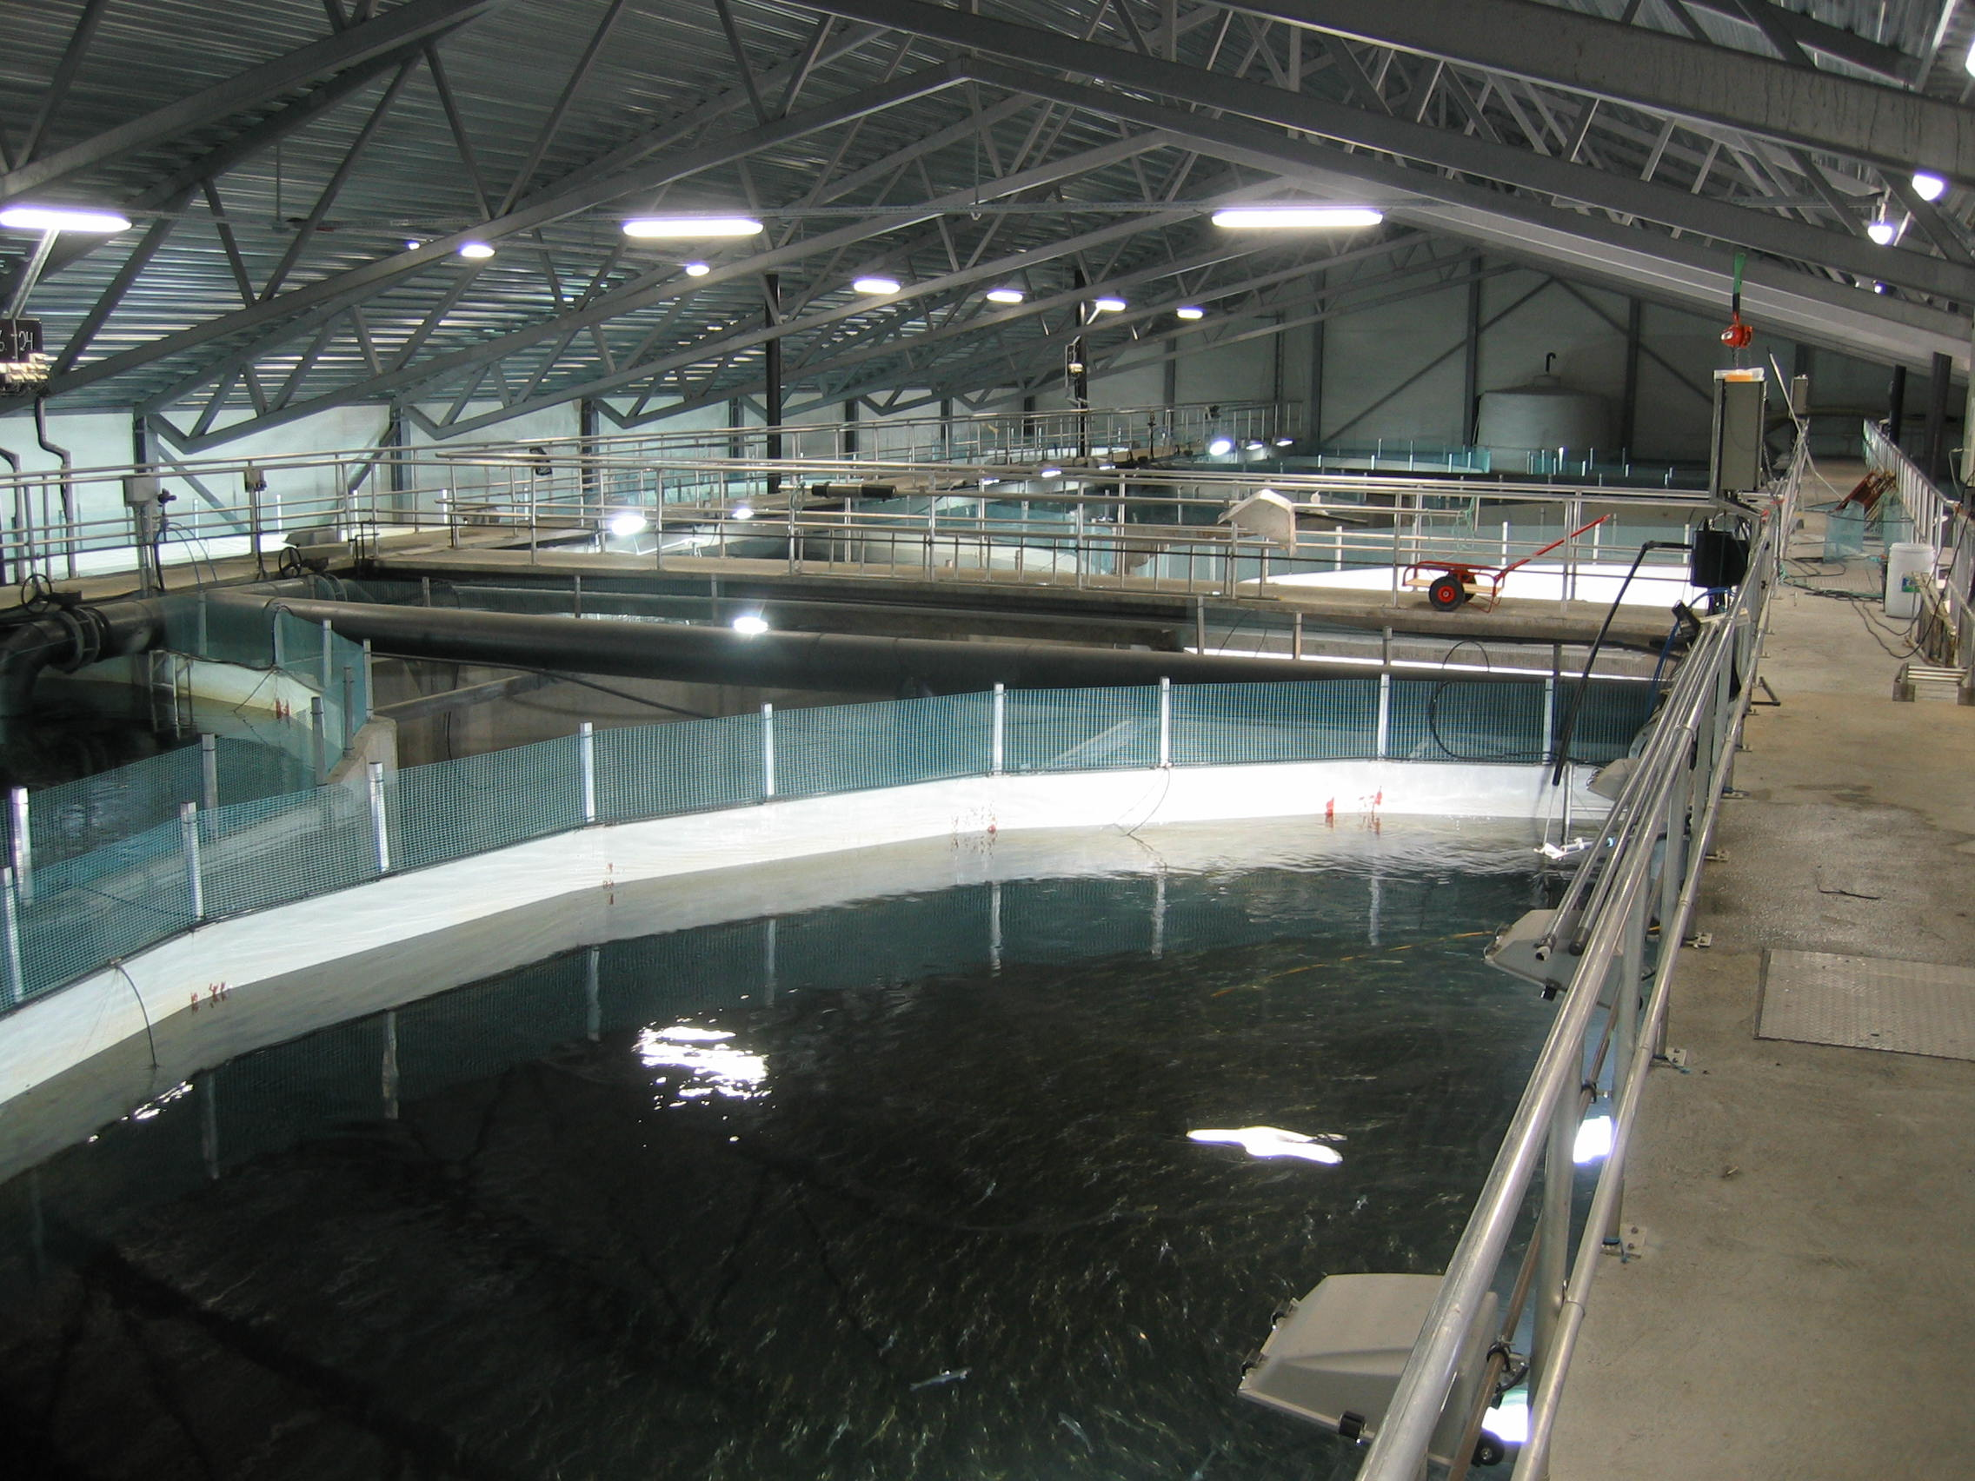
STATE OF THE ART RAS TECHNOLOGY
Notes:
Fresh water grow out

Slide 14
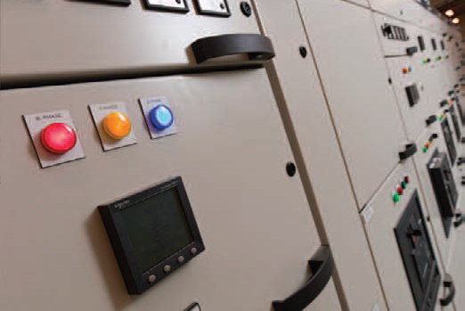

Slide 15
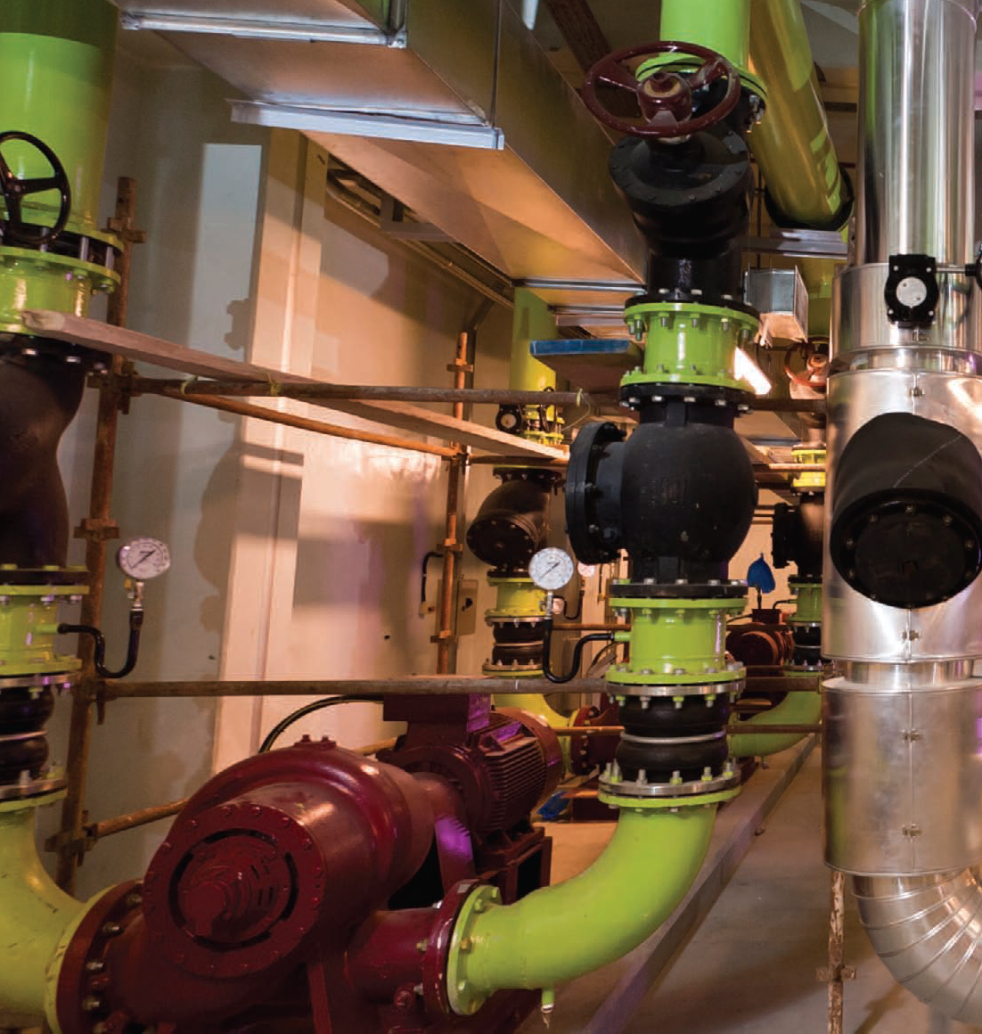

Slide 16
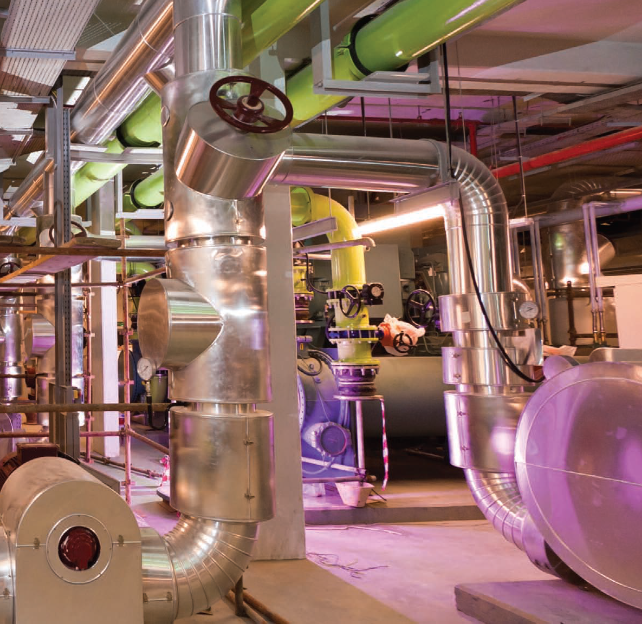

Slide 17
BILLUND AQUACULTURE – THE WORLD CLASS SUPPLIER OF R.A.S. SOLUTIONS
SINOR’s exclusive supplier is currently located in Denmark, Norway, China and Chile
More than 27 years of experience in design, installations, operation and service of intensive re- circulation fish industrial production units
Worldwide built more than 111 unique re-circulated systems for 24 different salt- and freshwater species in 24 countries, with several new projects pending
Notes:
Good for both the MICRO as well as MACRO
Live supply directly to restaurants
Distance to market will continue to shrink
Consumer satisfaction guarantee return on investment

Slide 18
LAND BASED PRODUCTION OF SALMON or TROUT IN R.A.S. TECHNOLOGY
Introduces a healthy and safe consumer product, reducing medical care
Control of all production parameters
Substitutes approx. 60 % of import of similar fish for domestic consumption - improving the trade balance
Represents excellent Export potential
New distribution opportunities
Environmentally safe - waste treatment represents earnings
Premium quality, product development – and pricing
Traceable fish quality parameters
Notes:
Good for both the MICRO as well as MACRO
Live supply directly to restaurants
Distance to market will continue to shrink
Consumer satisfaction guarantee return on investment

Slide 19
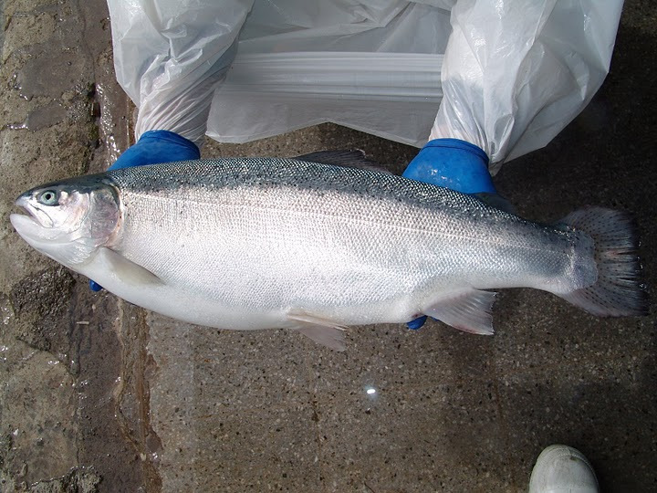

Slide 20
Trout
Triploid eggs are used for the production of very large, sterile (never maturing) rainbow trout in salt or fresh water
These fish will continue to grow throughout their life without the characteristics and setback of maturation, allowing the fish farmer to produce (almost) whatever size of fish desired.

Slide 21
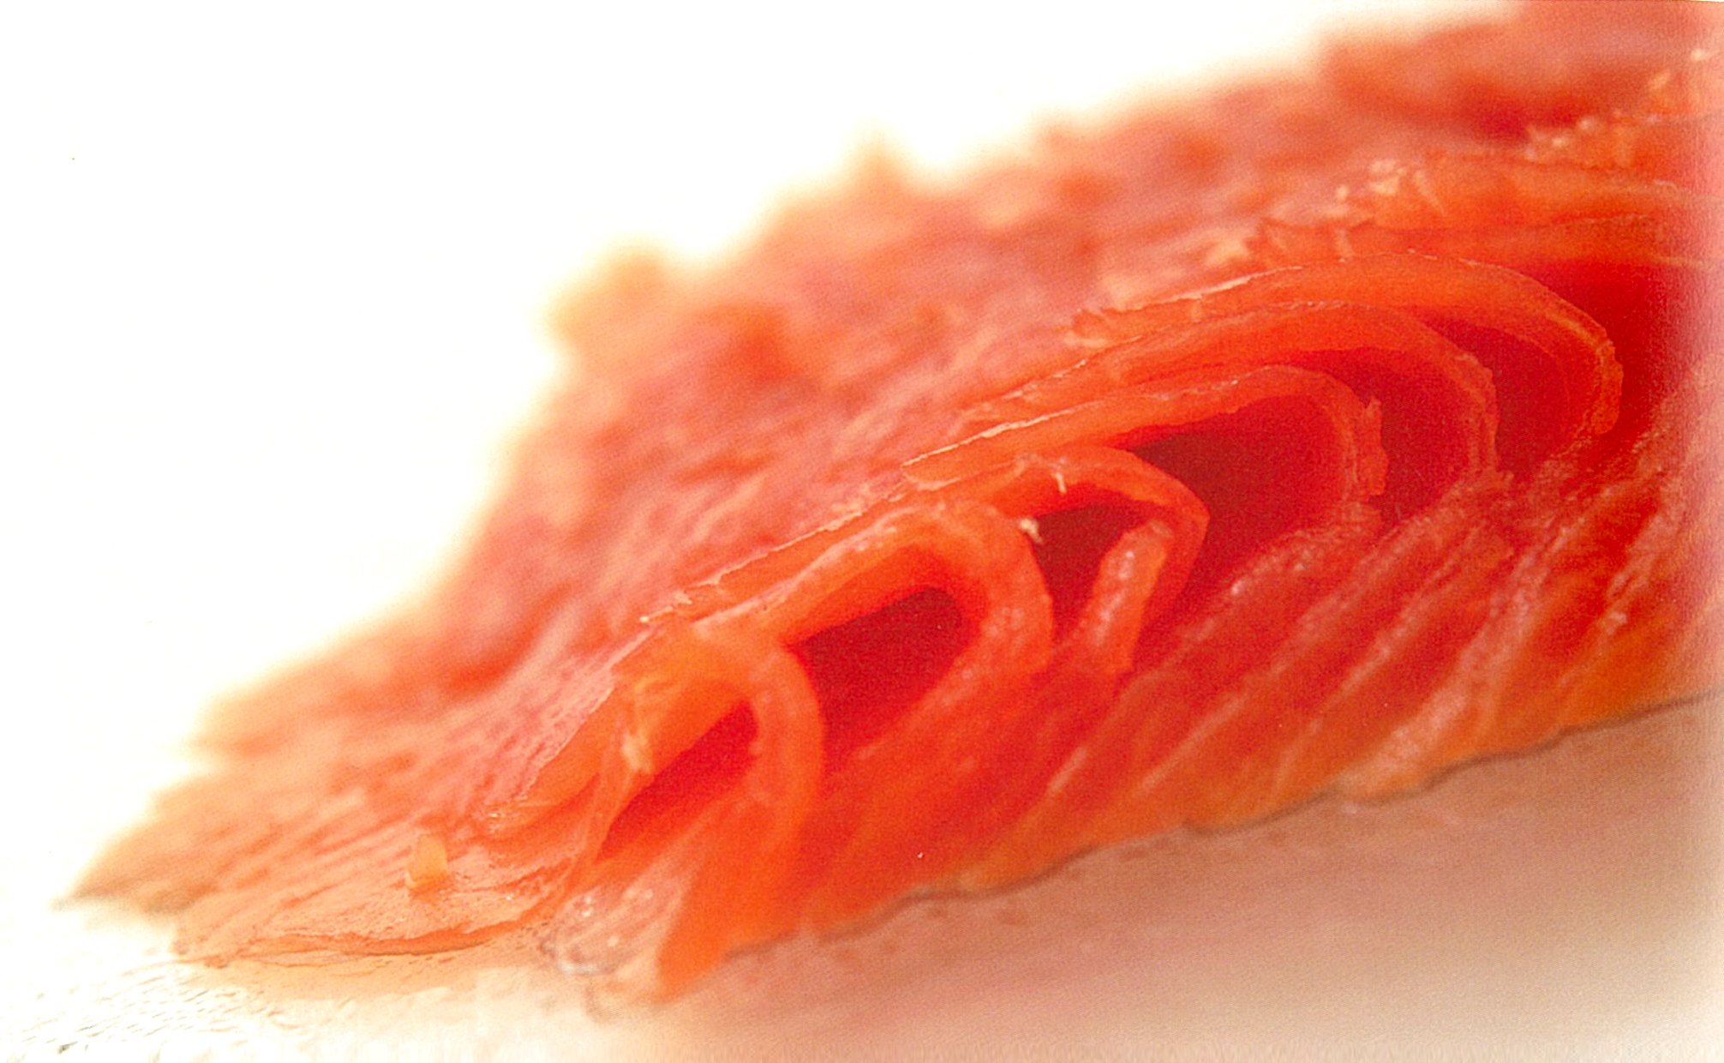
SALMON SASHIMI QUALITY
Notes:
Most food lovers prefer FJORD SALMON for their sashimi
The SAHIMI cut is from selected salmon in terms of size and fat distribution; absolutelly premium Color – texture – taste.
Most people mix SASHIMI with RAW SALMON. That is WRONG.

Slide 22
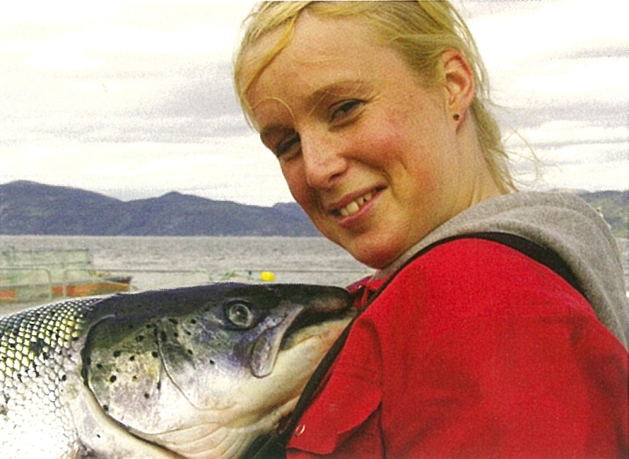
MANAGEMENT: NATURAL, HEALTHY, QUALITY & SAFE
Notes:
THE SUCCESS IS ALL ABOUT DOING
In line with nature’s conditions, ensuring the product quality
Appreciated by the consumer

Slide 23
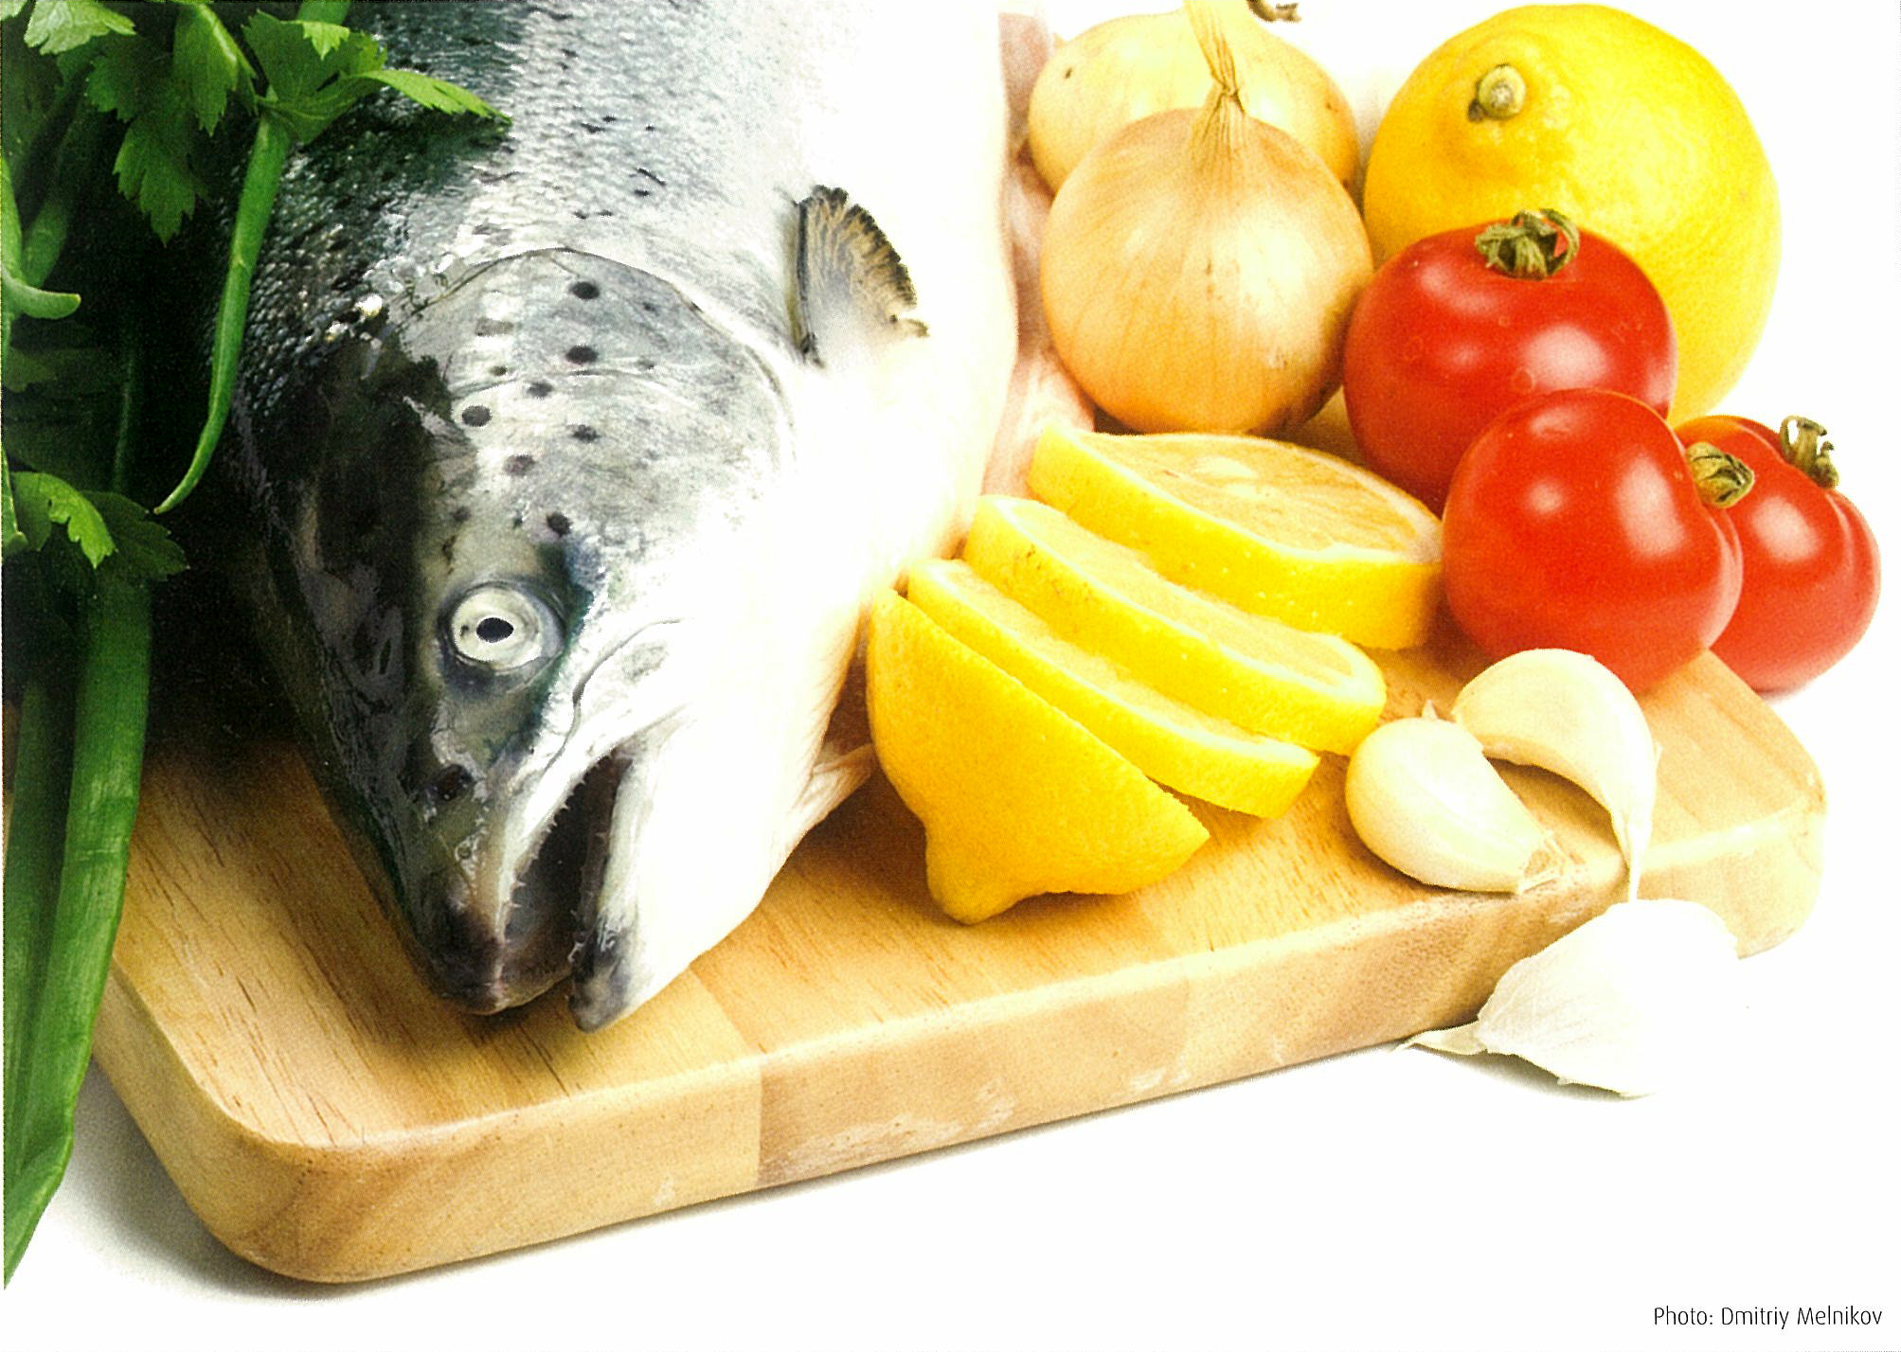
A NEW FISH BECOMING FAMOUS

Slide 24
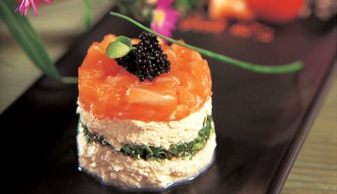
SALMON TOFU WITH BELUGA CAVIAR
Notes:
TOFU & RAW SALMON - - - IT IS NOT SASHIMI

Slide 25
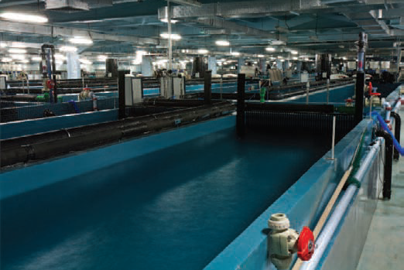
Notes:
Grow out facilities 20.000 m2

Slide 26
WATER SOURCES
It is preferable to take water from drilled wells, which doesn’t effect surface water resources
Discharge water and sludge do not represent any environmental problem, is stored and normally be used as fertilizer

Slide 27
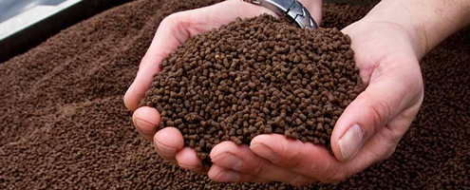
WORLD CLASS FEED
Notes:
HEALTHY and environmental FEED

Slide 28
FEED FOR THE TROUT or SALMON
The life cycle of the trout or SALMON in RAS will require a number of scientifically developed feed formulations to meet the need for minerals, vitamins, fat and protein.
Fish feed is basically produced by 3 major companies in the world.
To ensure the required quality of the fish, fish feed is in most countries imported.

Slide 29
VARIOUS FEED FORMULATIONS FOR THE LIFE CYCLE

Slide 30
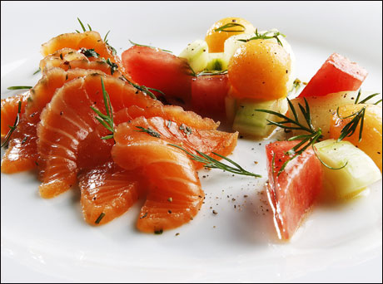
NORWEGIAN ATLANTIC SALMON
Notes:
QUALITY SMOKED & MARINATED SALMON
- HIGHLY PRICED & DEMANDED PROCESSED PRODUCTS

Slide 31
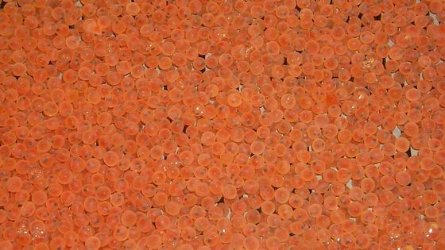
SECURE & GUARANTEED EGGS
Fertilized salmon eggs
Notes:
SAFE EGGS

Slide 32
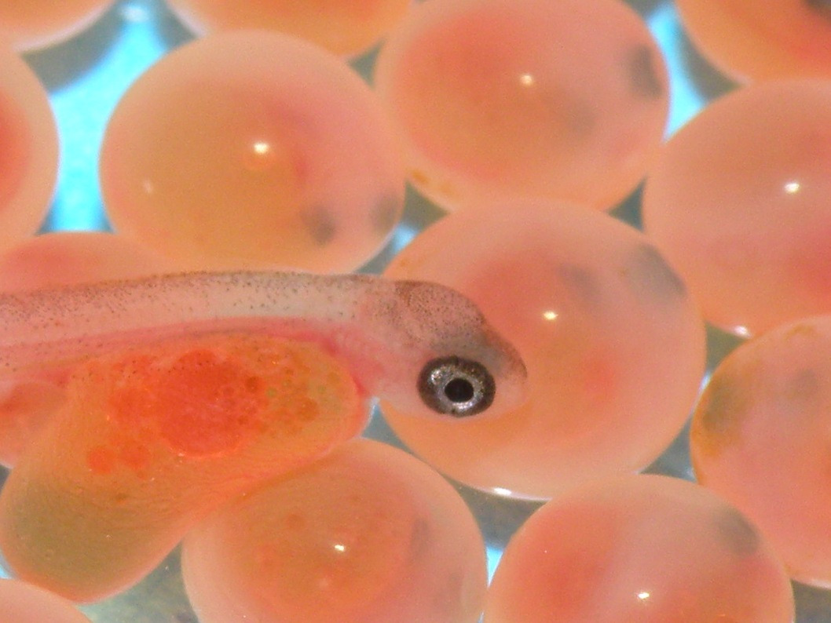

Slide 33
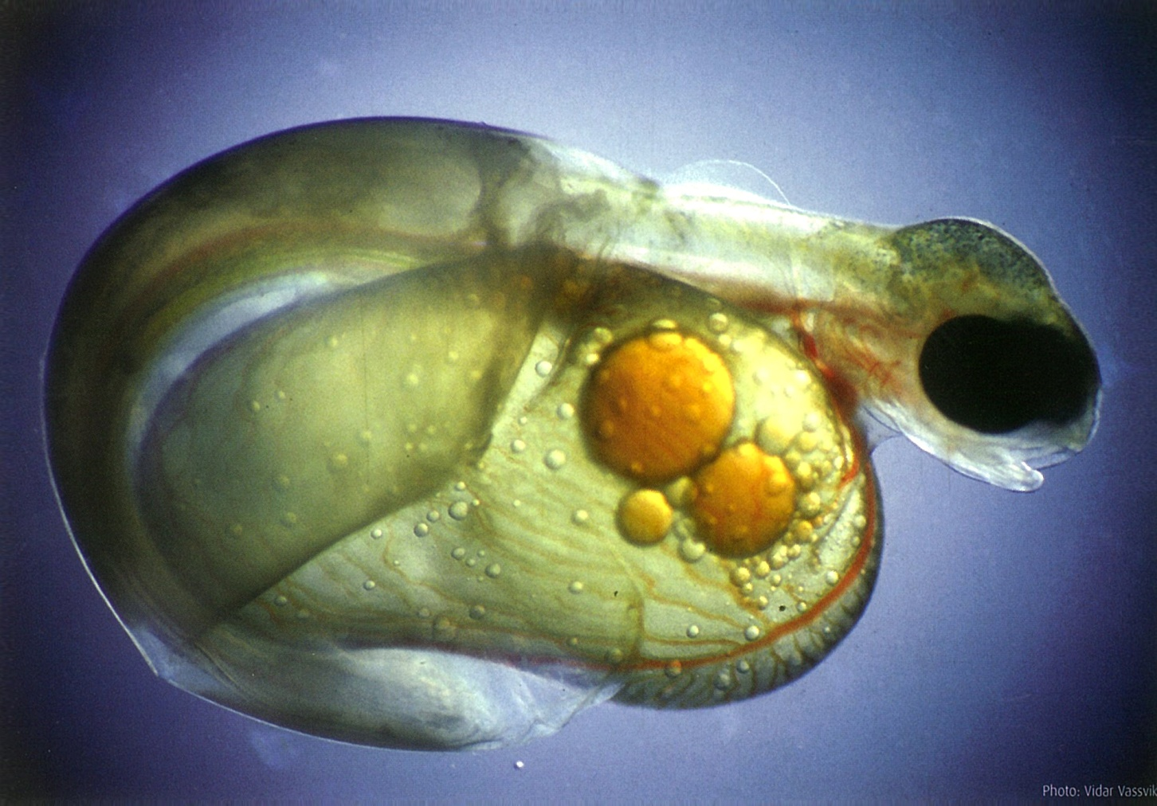
BLUE ECONOMY – SUSTAINABILITY
Notes:
TODAY, NORWEGIAL SALMON INDUSTRY applies ZERO antibiotics in the production of quality salmon.
Vaccination and better general knowledge of management ensure this remarkable achievement.
THE BLUE ECONOMY will make its return from protecting the life of its produce and ensuring safe products to its customer.

Slide 34
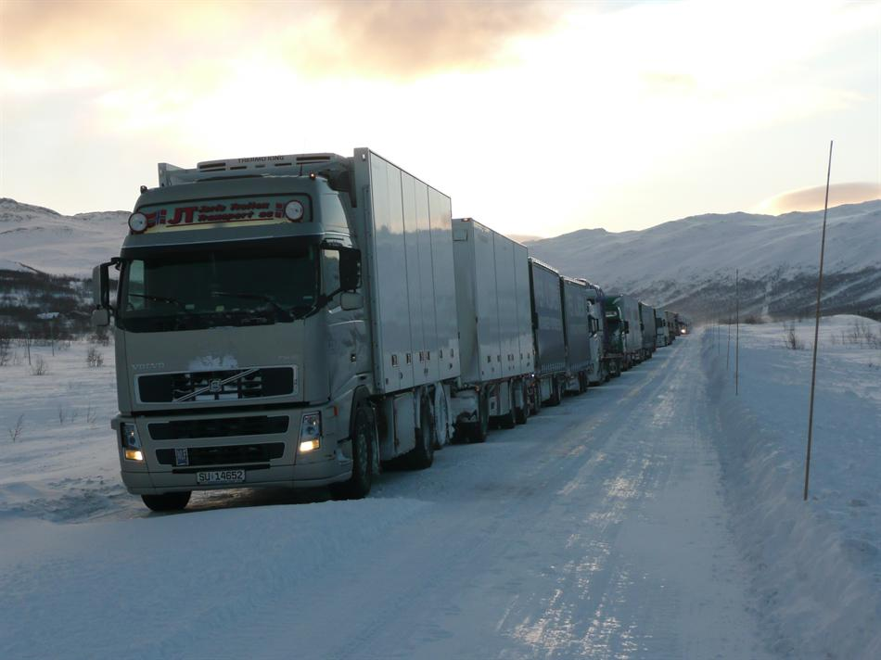
EXPORT OF LIVE TROUT

Slide 35
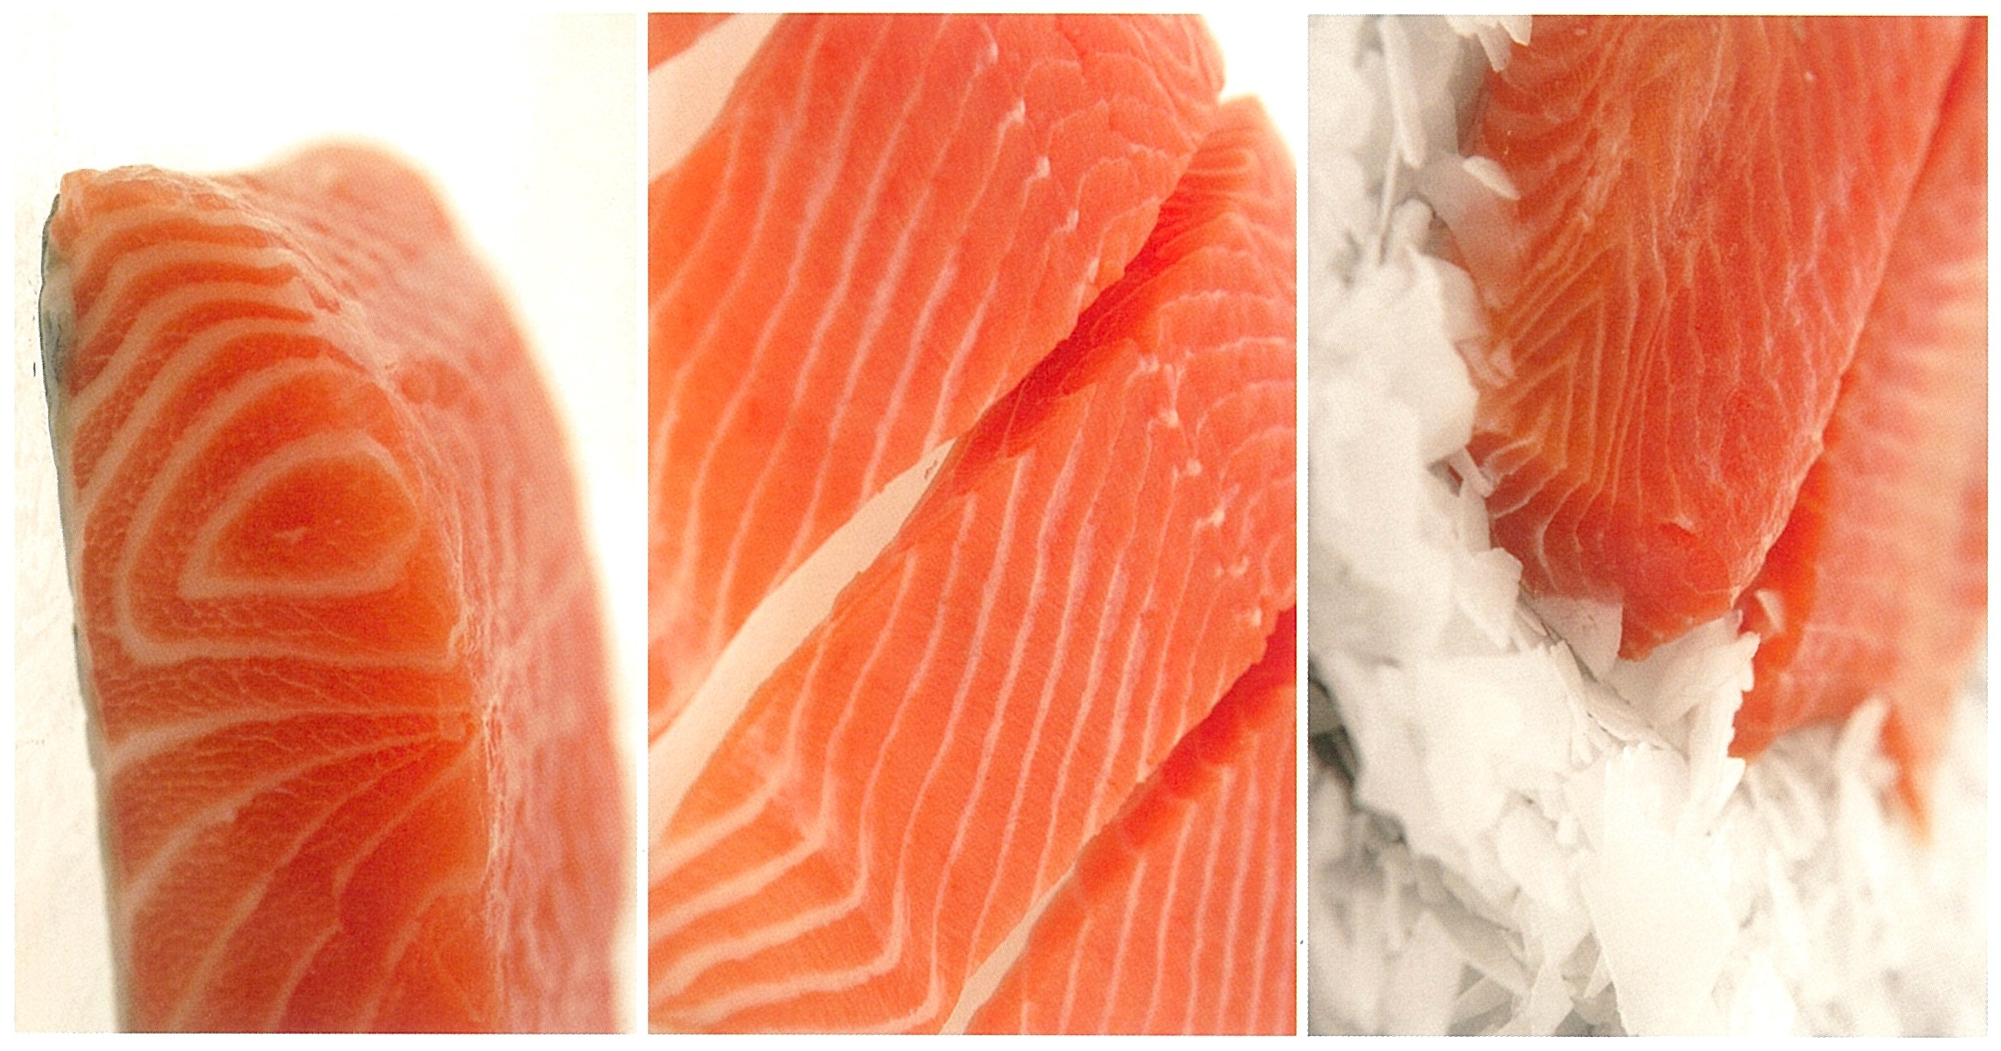
DIFFERENT FLESH QUALITIES
Notes:
3 QUALITIES – 2 from salmon ONE FROM TROUT
DISTRIBUTION OF FAT, COLOR, TEXTURE, BUT NOT FLAVOUR
Markets demand different colors & fat distribution
Duplication of NATURE – natural fish diet varies – DO DOES INDUSTRIAL PRODUCED FEED

Slide 36
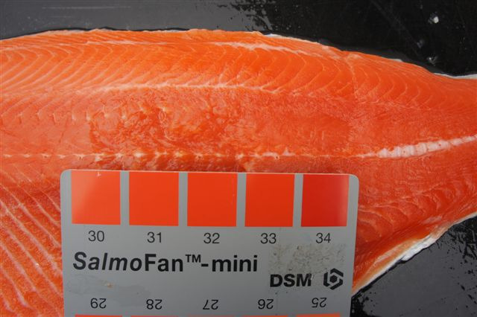
TROUT: Colour chart 31 to 34

Slide 37
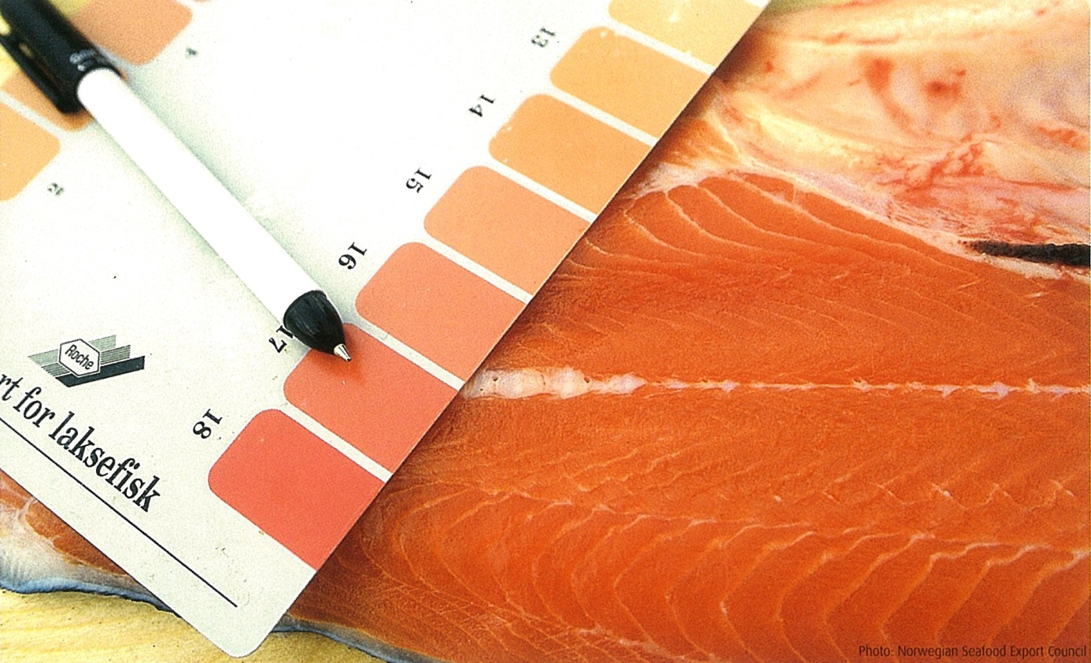
SALMON: colour chart 27 to 28
Notes:
COLOR REFERENCE
NO BETTER PLACE TO CONTROL THIS THAN IN a R.A.S. Technology

Slide 38
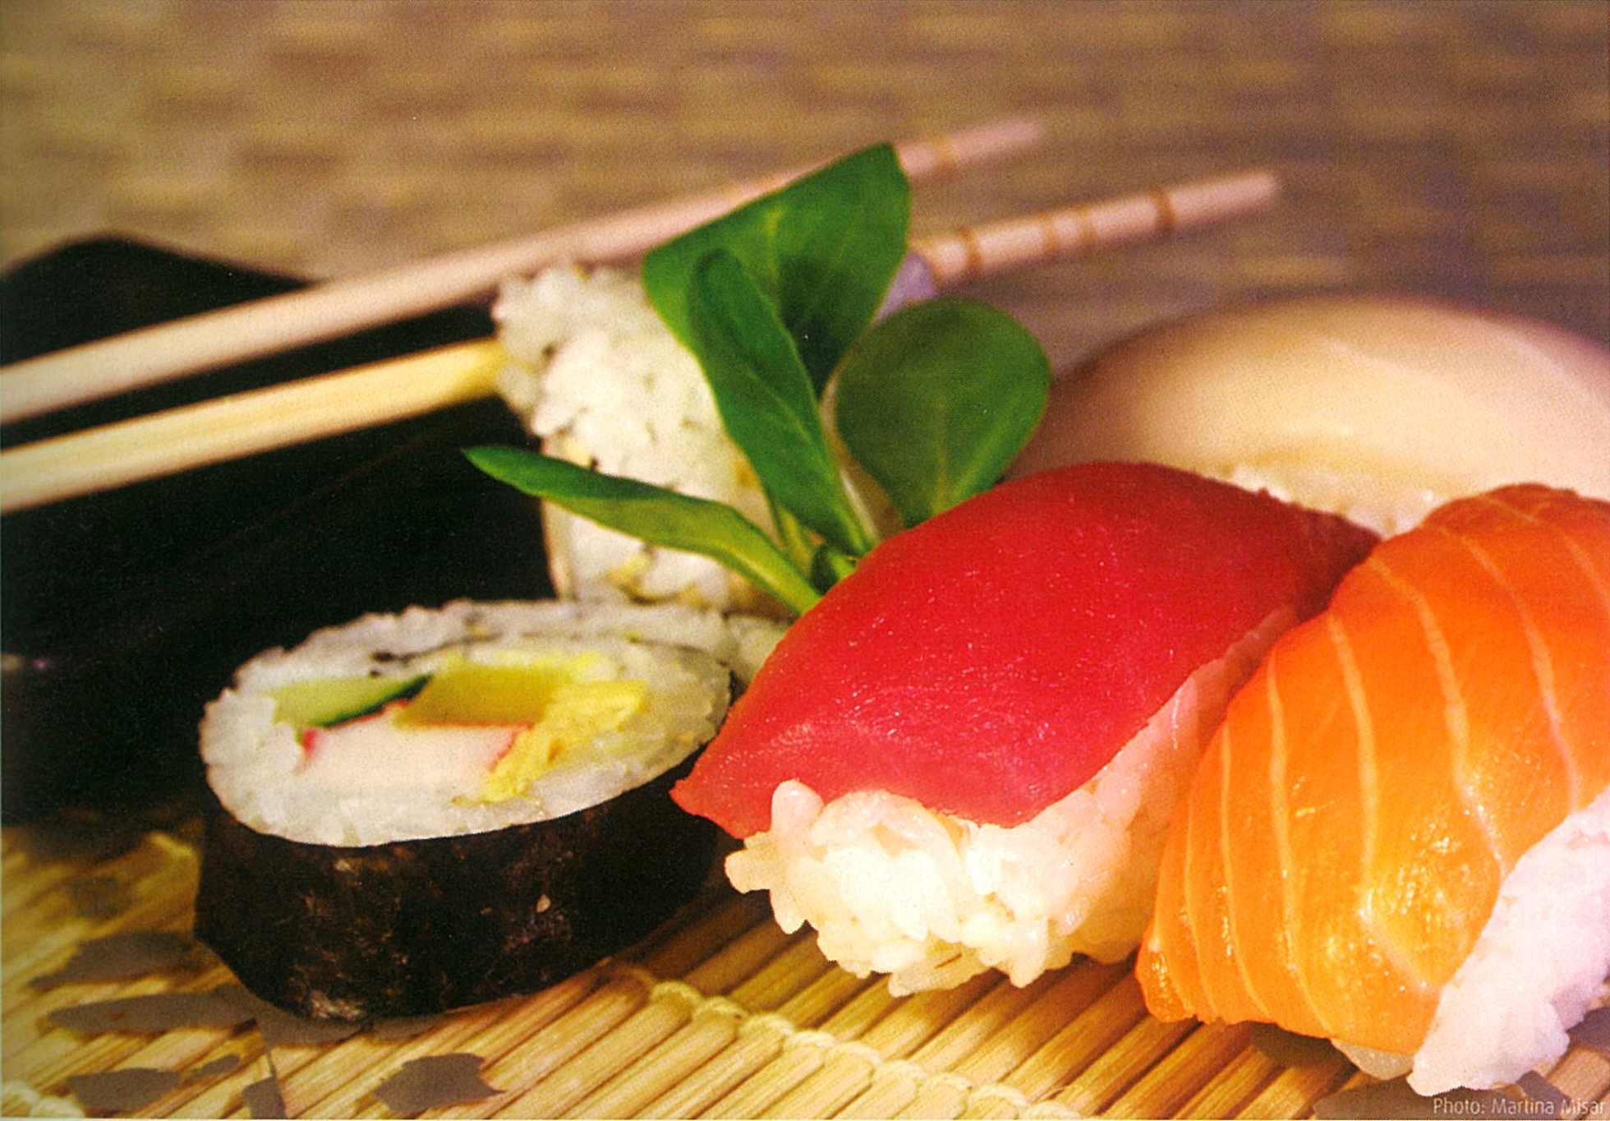
QUALITY SUSHI
Notes:
OBSERVE the color of the Atlantic Salmon from this Japanese Restaurant
Distribution of fat – evenly & not overwhelming
………..and the very special

Slide 39
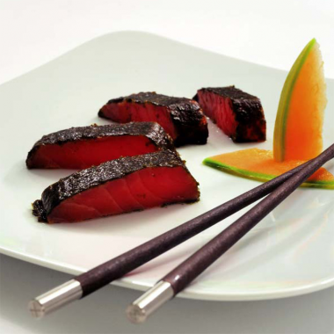

Slide 40
DIFFERENT TYPES OF SALMON &TROUT
Pacific Salmon and Trout (14 species)
SALMO - Atlantic Salmon and Trout (29 species)
All salmonoids spawn in fresh water, but spend most of their life at sea
Returning to the rivers only to reproduce
This type of life cycle is described as anadromous
They are predators, feeding on small crustaceans, aquatic insects, and fish

Slide 41
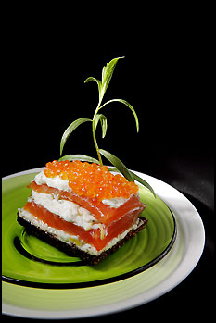
Notes:
SALMON – THE PLEASURE OF THE BLUE ECONOMY
Challenges………….

Slide 42
“FROM HEALTHY EGGS TO THE DINING TABLE.” Safe, premium quality, industrially produced Norwegian Atlantic SALMON and Trout
Mr. Morten Tangen,
CEO SINOR AS
Beijing 16th of APR 2013
Notes:
NI HAO. Lectures from world class suppliers.
Put development process into a historical perspective by visualizing some factors
SALMON FARMING to INDUSTRY. From ignorance into Sciense. And from Bankruptcies to CASH MACHINE

Slide 43
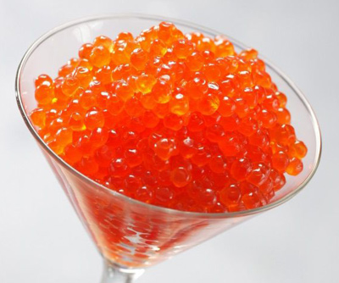
Notes:
GAMBEI!

